Slide 1

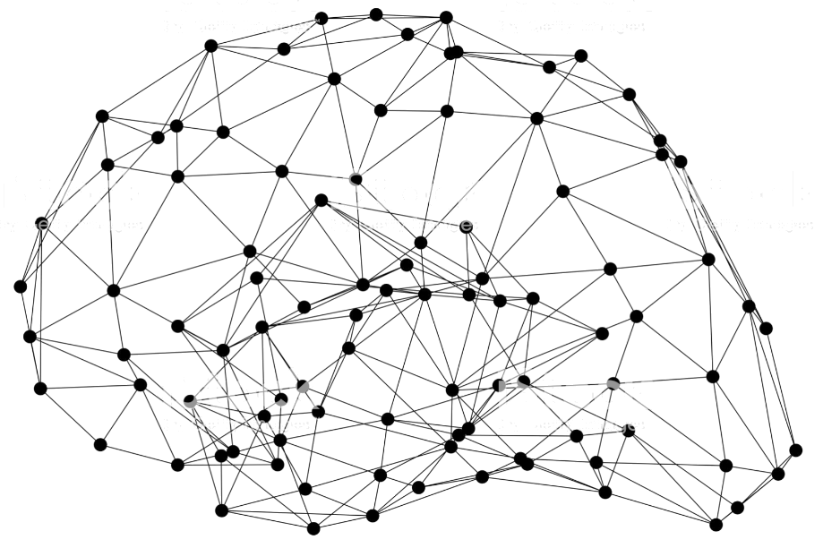
GluonCV: Video Action Recognition

Slide 2
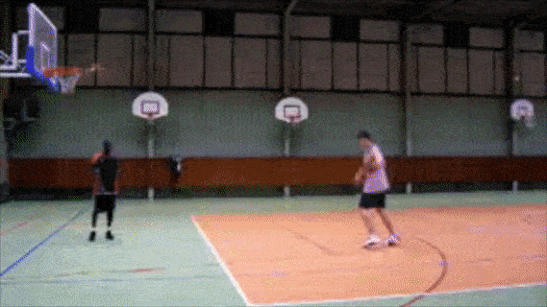
What’s video action recognition?
Recognize what action is the person doing in a video

Slide 3
Why video action recognition?
Classification problem (with temporal dimension), serves as basis for various video tasks, such as video object detection, video event localization, video retrieval, video recommendation, etc.
Useful applications, such as surveillance monitoring, robotics, gaming, human motion analysis, etc.

Slide 4
Popular models and datasets
Two-stream networks
TSN (temporal segment networks)
C3D
P3D
I3D
S3D
R(2+1)D
Non-local neural networks
TRN (temporal relation networks)
SlowFast
TSM (temporal shift module)
UCF101
HMDB51
Sports1M
ActivityNet
Charades
Kinetics400/600/700
Moments in time
HACS
Something-something-v1/v2

Slide 5
Popular models and datasets (what we have)
Two-stream networks
TSN (temporal segment networks)
C3D
P3D
I3D
S3D
R(2+1)D
Non-local neural networks
TRN (temporal relation networks)
SlowFast
TSM (temporal shift module)
UCF101
HMDB51
Sports1M
ActivityNet
Charades
Kinetics400/600/700
Moments in time
HACS
Something-something-v1/v2
Notes:
Since action recognition receives less attention due to it’s expensive training and inference cost, I will do a mini literature survey here

Slide 6
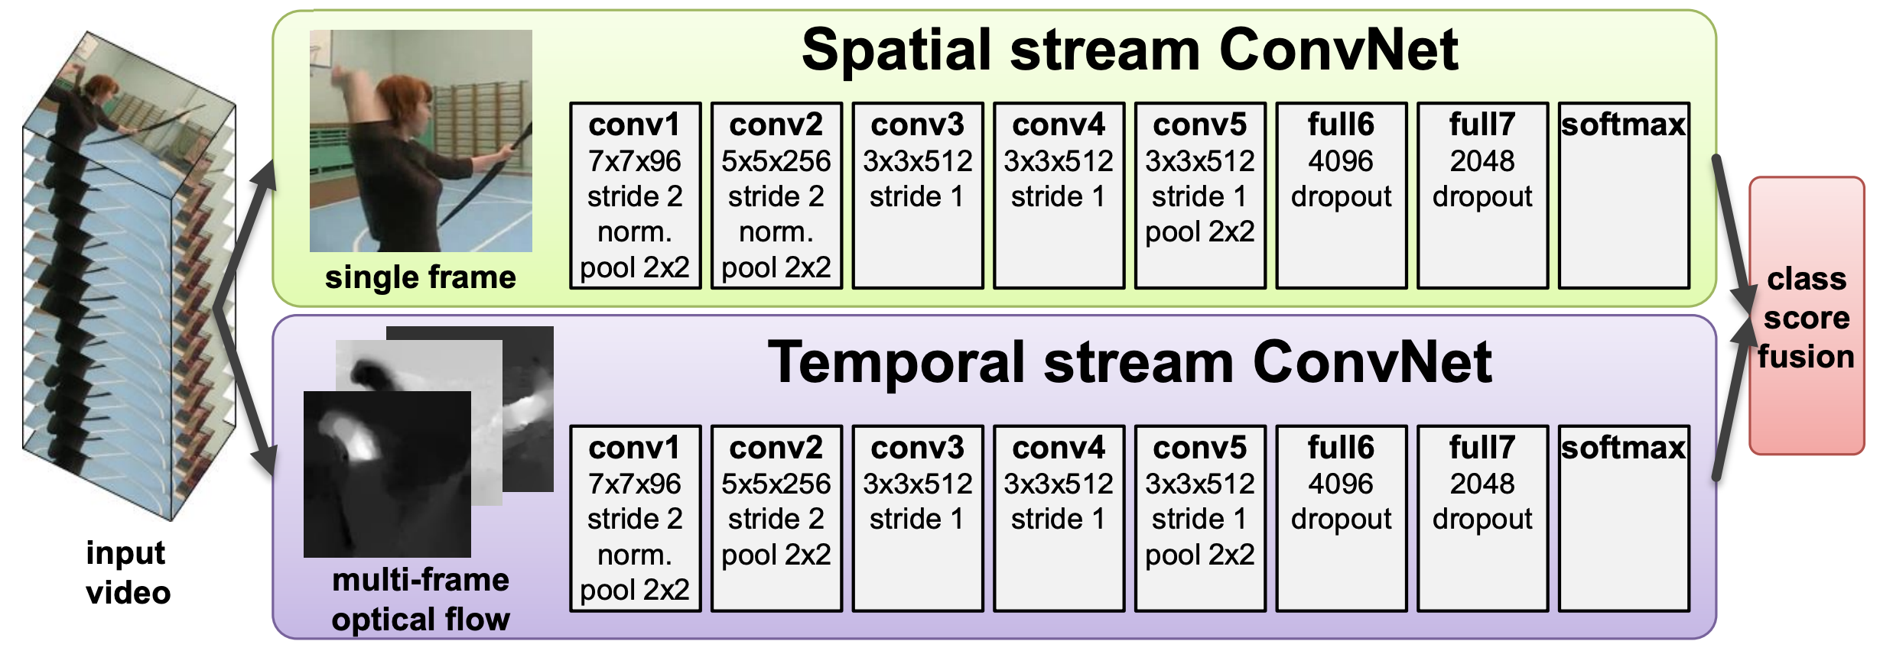
Two Stream Networks
Use optical flow to introduce temporal information
Karen Simonyan and Andrew Zisserman, Two-Stream Convolutional Networks for Action Recognition in Videos, NeurIPS 2014
Notes:
For image classification, we have a single deep network to capture the appearance information of the image, such as object shape, color, texture, etc. For video classification, appearance information is not enough to distinguish many activities, e.g., stand up and sit down. We need to reason temporal information. This work use optical flow to describe the motion information between frames and achieve significant improvements for video classification problems. (optional: you can also introduce a bit what is optical flow.)

Slide 7
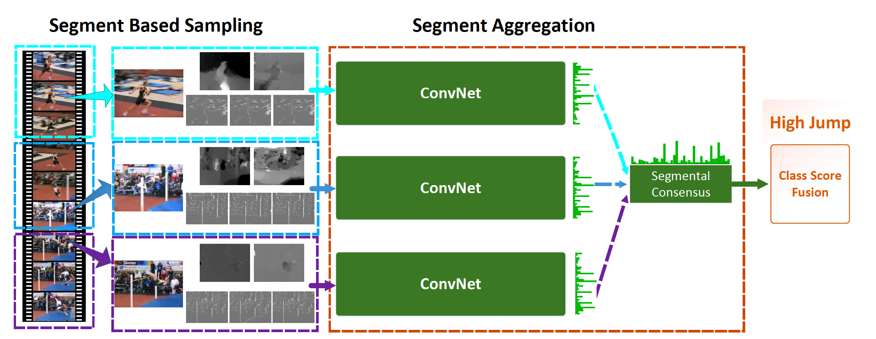
Temporal Segment Networks
Introduce segments to reason longer temporal context
Limin Wang, et al., Temporal Segment Networks: Towards Good Practices for Deep Action Recognition, ECCV 2016
Notes:
TSN is a follow-up work of two-stream networks. Its goal is to capture long-range temporal information. As we can see in the figure, a video is evenly divided into several segments. In this example, we set the number of segments to be 3. For each segment, we randomly pick a RGB frame as input to the spatial stream, and a sequence of optical flow images as input to the temporal stream. In the end, we take a consensus among the outputs from the three segments. The consensus function can be a simple max/average pooling, or weighted average pooling or more advanced bilinear pooling or non-local operation. In this manner, the TSN framework can capture most of the temporal information throughout a video and make a better decision on what the action might be.

Slide 8
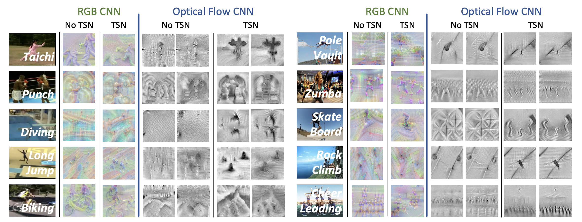
Temporal Segment Networks
Notes:
To attain further insights, TSN adopts the DeepDraw toolbox to visualize what the model has learned. This tool conducts iterative gradient ascent on input images with only white noises. Thus the output after a number of iterations can be considered as class visualization based solely on class knowledge inside the CNN model. We randomly pick five classes from the UCF101 dataset, Taichi, Punch, Diving, Long Jump, and Biking, and five classes from the ActivityNet dataset, Poole Vault, Zumba, Skate Board, Rock Climb, and Cheer Leading.
It is easy to notice that the models, trained with only short-term information such as single frames, tend to mistake the scenery patterns and objects in the videos as significant evidences for action recognition. For example, in the class “Diving”, the single-frame spatial stream CNN mainly looks for water and diving platforms, other than the person performing diving. Its temporal stream counterpart, working on optical flow, tends to focus on the motion caused by waves of surface water. With long-term temporal modeling introduced by temporal segment network, it becomes obvious that learned models focus more on humans in the videos, and seem to be modeling the long-range structure of the action class. Still consider “Diving” as the example, the spatial CNN with temporal segment network now generate an image that human is the major visual information. And different poses can be identified in the image, depicting various stages of one diving action. Similar observation would be identified in other action classes such as “Long Jump” and “Skate Board”. This suggests that models learned with the proposed method can perform better for video classification.

Slide 9
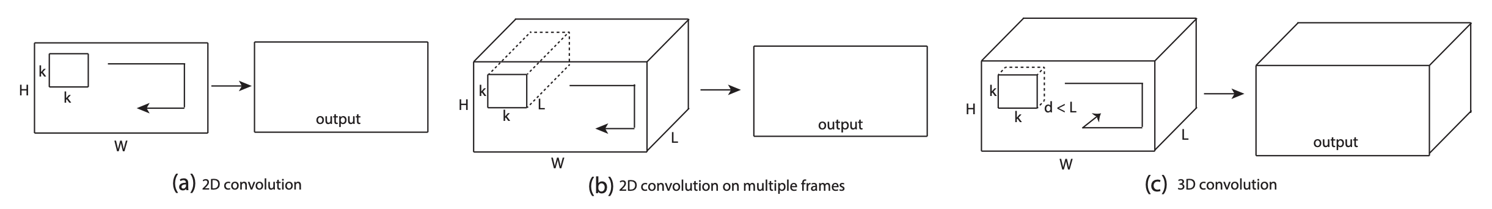
C3D
Use 3D convolution network to learn spatiotemporal features for video applications
Du Tran, et al., Learning Spatiotemporal Features with 3D Convolutional Networks, ICCV 2015
Notes:
However, computing optical flow is time-consuming, which makes the whole framework not real-time runnable. Video applications usually require real-time performance. Hence, we need a new way to introduce temporal information into the picture. The original C3D is proposed in ICCV 15. It is a 3D convolutional neural network. It has a similar structure with VGG16, however, all the 2D kernels (3x3) have been replaced by 3D kernels (3x3x3).

Slide 10
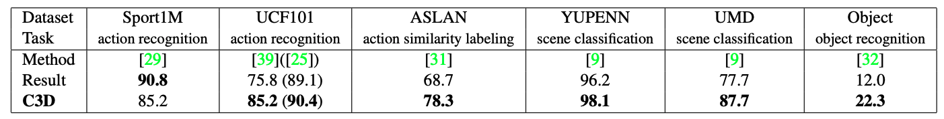
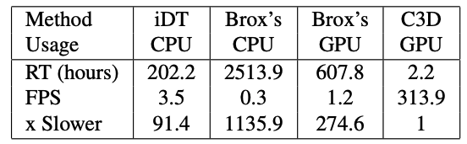
C3D
Generalizable to various video applications.
Fast inference.
Notes:
This network can learn spatiotemporal features for various video applications. As can be seen in the table, it works for action recognition, action similarity labeling, scene classification and object recognition. In addition, its inference speed is very fast, at 313.9 fps, which is much faster than the real-time requirement (25 fps). Hence, C3D has been widely used in real-world applications.
However, C3D has several limitations. First, the training takes time. For example, training a C3D network from scratch on a large-scale dataset Sports1M takes a month. Second, the performance is not as good compared to flow-based methods.

Slide 11
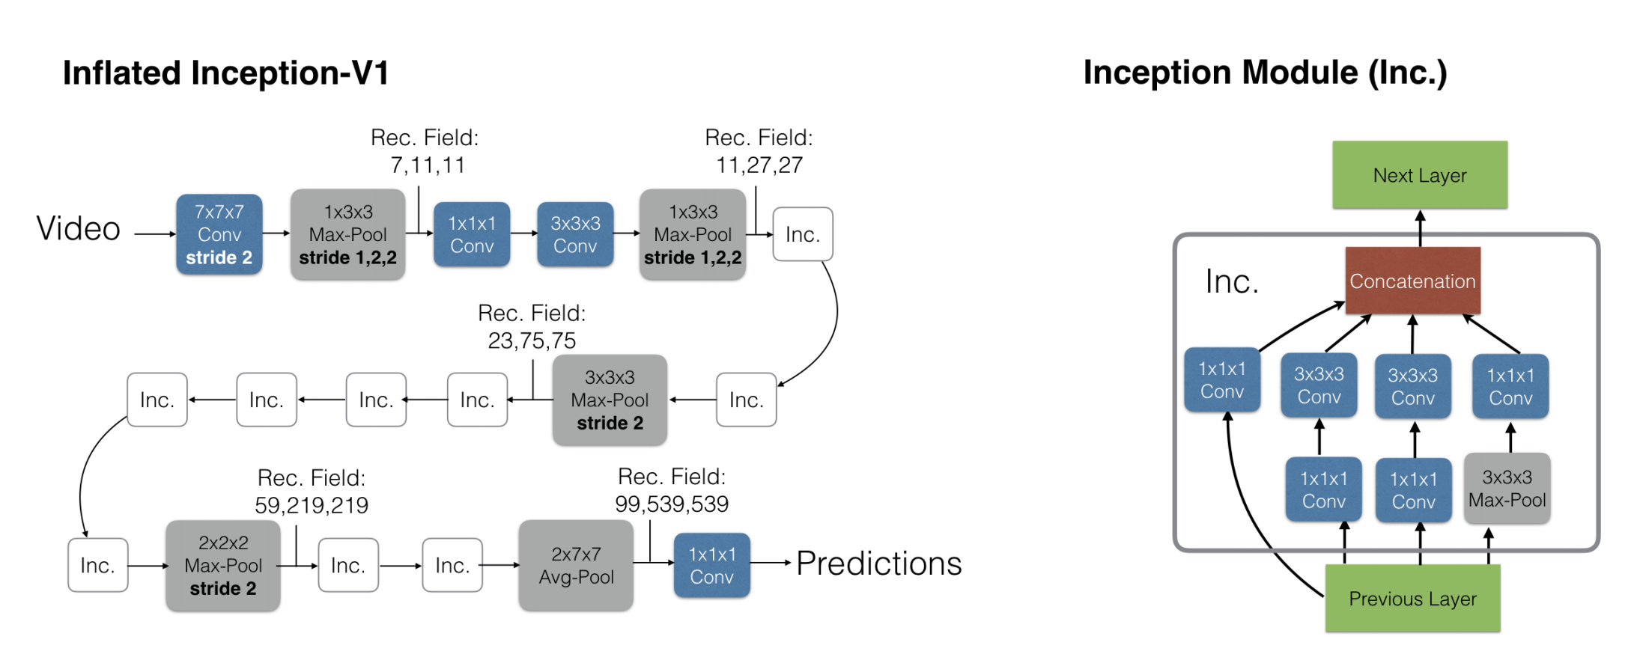
I3D
Inflating 2D CNNs to 3D, and bootstrapping 3D filters from 2D filters
Joao Carreira and Andrew Zisserman., Quo Vadis, Action Recognition? A New Model and the Kinetics Dataset, CVPR 2017
Notes:
So we turn to I3D. I3D is a follow-up work of C3D, but with many improvements. First, its name is inflated 3D networks. Since there are many well-developed 2D network architectures, the authors simply use a Inception-V1 2D model and inflated it into a 3D network. Second, since these 2D networks are well initialized (pre-trained on ImageNet), we don’t want to waste it. So I3D bootstrap all 3D filters from 2D filters. The operation is to repeat the weights of the 2D filters N times along the time dimension, and rescaling them by dividing by N. This ensures that the convolutional filter response is the same. Because I3D is well-designed and well-initialized, it achieves competitive performance with flow-based methods.

Slide 12
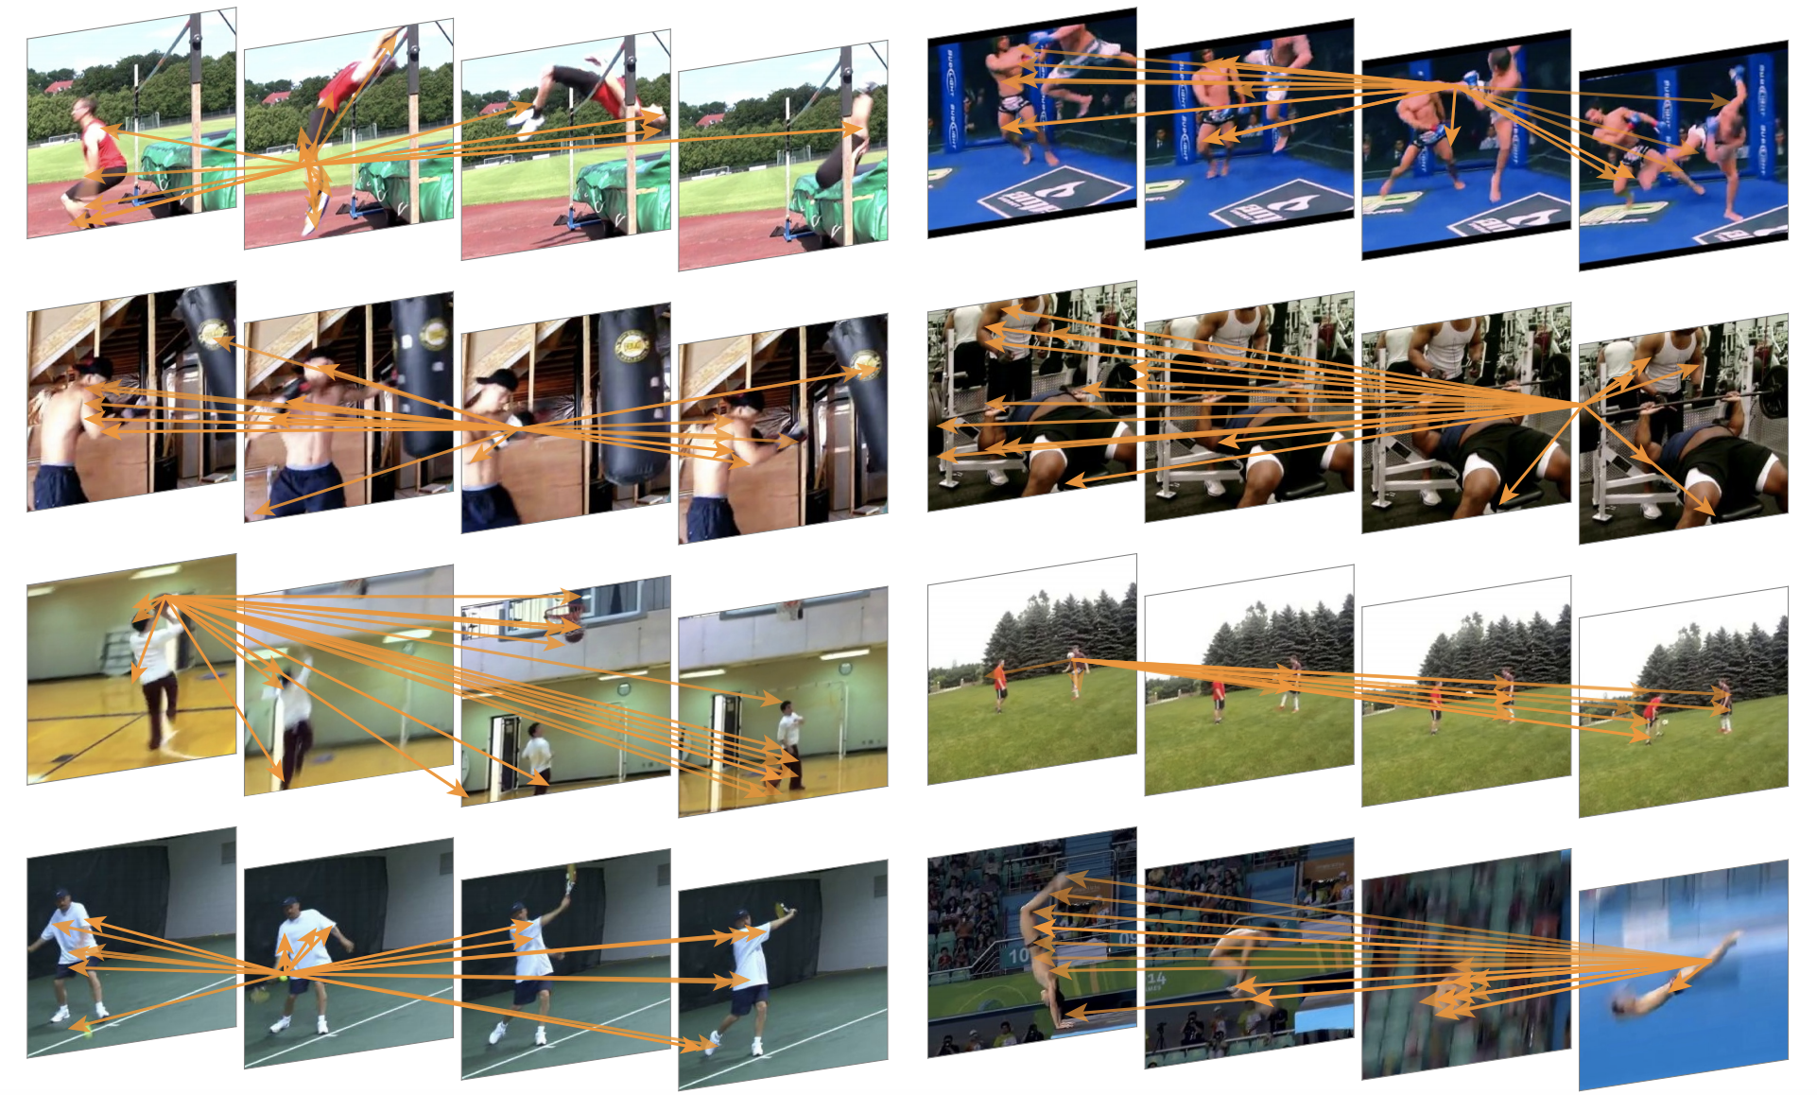
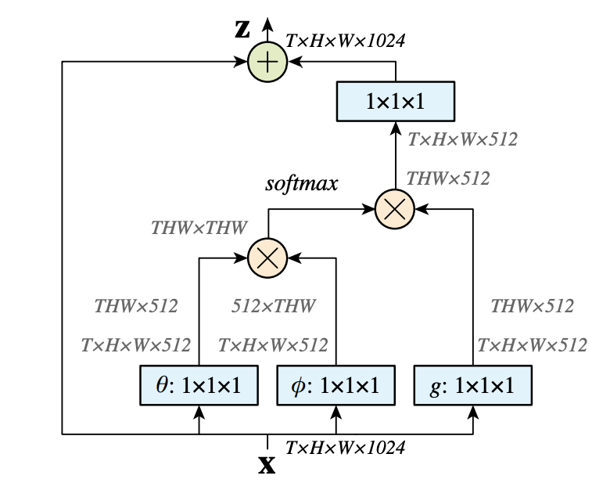
Non-local Neural Networks
Introduce non-local (self-attention) block to capture long-range temporal dependencies.
Xiaolong Wang et al., Non-local Neural Networks, CVPR 2018
Notes:
Again, even 3D network can not capture long-range temporal information. Usually the input to the network is 16, 32 or 64 frames. That is about 2 seconds of video. Sometimes it can not cover the whole duration of an action. Inspired by the classical non-local means method in computer vision, Wang introduces a non-local operation that computes the response at a position as a weighted sum of the features at all positions. This is now also known as self-attention. (optional: you can introduce self-attention a bit). This module can be plugged into many computer vision architectures and help capture long-term dependencies.

Slide 13
Implement SOTA Video Action Recognition Models with GluonCV
Method | Metric | GluonCV | Reference
TSN-VGG16 | Top-1 acc on UCF101 | 83.4% | 82.8 (TSN)
TSN-InceptionV3 | Top-1 acc on Kinetics400 | 72.5% | 72.5% (TSN)
I3D-InceptionV1 | Top-1 acc on Kinetics400 | 71.7% | 71.1% (paper)
I3D-ResNet50 | Top-1 acc on Kinetics400 | 73.6% | 72.9% (MMAction)
I3D-NL-ResNet101 | Top-1 acc on Kinetics400 | 75.3% | 76.0% (paper)
TSN-ResNet50 | Top-1 acc on something-something-v2 | 35.5% | 30.0% (paper)
SOTA pre-trained models (RGB input)
Notes:
All the models listed here work on RGB input. There is no optical flow involved.
We list some widely used models here and compare with the original reference paper or open source implementations, such as TSN, I3D and non-local models. As we can see, our results on three datasets are comparable or better than those benchmarks.
Note one exception that, our NL model is 0.7% lower than the paper reported number. This is reasonable since Kinetics400 is consisted of YouTube videos, there are more and more videos missing or blocked. For example, we are in short of 15K training videos. So a gap of 0.7% is within the reproducible range.

Slide 14
Implement SOTA Video Action Recognition Models with GluonCV
Data API
Automated data preparation
Dataset
Image/Video dataloader
Transformation API
Metric API
Loss API
Pre-defined network architectures
Building-blocks
Custom Layers
Reproducible Experiments
Training Script
Configurations
Available in GluonCV

Slide 15
Fast Data Loading
Our frame-based data loader is 1.3x faster than mmaction toolkit (https://github.com/open-mmlab/mmaction)
We also support loading videos directly during training. Our video loader (decord: https://github.com/zhreshold/decord) is 6 times faster than OpenCV “cv2.VideoCapture”.
Our code support distributed training across multiple machines.

Slide 16
Complete Model Zoo
Two-stream networks
TSN (temporal segment networks)
C3D
P3D
I3D
S3D
R(2+1)D
Non-local neural networks
TRN (temporal relation networks)
SlowFast
TSM (temporal shift module)
UCF101
HMDB51
Sports1M
ActivityNet
Charades
Kinetics400/600/700
Moments in time
HACS
Something-something-v1/v2
More are coming soon in the next release.
Notes:
We will eventually support all the models, and most of the datasets.

Slide 17
Why Use GluonCV Video Toolkit?
Compared to existing open source toolkits for video classification (MMAction, PyVideoResearch, TorchVision 0.4 Video),
Our model zoo coverage is more complete (2D, 3D, 2+1D networks)
Fully reproducible results with training recipe and training logs
Faster data loading for quick experiment iteration
Detailed documentation and tutorials to get you started (feature extraction, fine-tuning, etc.)
We support more datasets
Unified train/test script, easy to understand and modify
Actively maintained

Slide 18
Hands On!

Slide 19

Like GluonCV? Go build!
https://github.com/dmlc/gluon-cv
https://gluon-cv.mxnet.io

